Slide 1
Metrology
Metrology is the science of measurement.
Metrology is the basis for empirical science and engineering in order to bring knowledge under general laws, i.e., to distil observations into formal theories and express them mathematically
R.Charanya,Assistant Professor,SITE, VIT University

Slide 2
Components of a measurement system:
m = <attribute, scale, unit>
Attribute is what is being measured (e.g., size of a program)
Scale is the standard and scope of measurement (e.g., nominal,ordinal, ratio scale, etc.)
Unit is the physical meaning of scale (e.g., a positive integer, a symbol, etc.)
Determining the value of an attribute of an entity.
Determining the class of entities to which the measurement relates.
R.Charanya,Assistant Professor,SITE, VIT University

Slide 3
Scales(History)
Stevens’ scales, were first presented in his 1946 article “On the theory of scales of measurement” [Stevens, 1946]. They have been adopted by most of the statistics textbooks and have consequently been influencing statistical experiments to date.
R.Charanya,Assistant Professor,SITE, VIT University

Slide 4
Representation of measurement
Empirical Relation Systems
Empirical relation system (C,R), where C is the set of entities and R is the set of empirical relationship.
Representation Condition
Mathematically representation of an expression, for example taller than (what does that really mean (>) )
Numerical relation system (N,P), where entities in C are mapped to numbers in N and empirical relations in R are mapped to numerical representation in P.
R.Charanya,Assistant Professor,SITE, VIT University

Slide 5
Representation Theory
Measurement theory tells us rules,for developing and reasoning about all kind of measurement.
Ties intuition to representations of attributes
Representations can be numeric or symbolic
Based on comparison between entities and how we represent them.
R.Charanya,Assistant Professor,SITE, VIT University

Slide 6
Empirical Relations
Formalizes our intuition
Based on our observations of the attributes of actual objects (physical or virtual)
We compare objects in terms of attributes
R.Charanya,Assistant Professor,SITE, VIT University

Slide 7
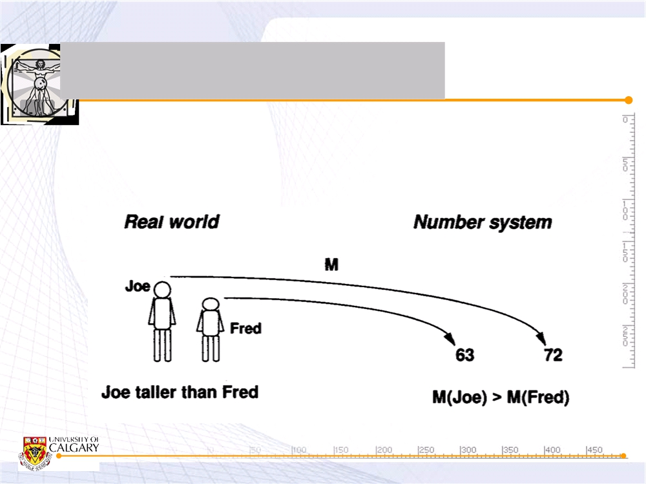
Empirical Relations
■ Empirical relation preserved under measurement M as numerical relation

Slide 8
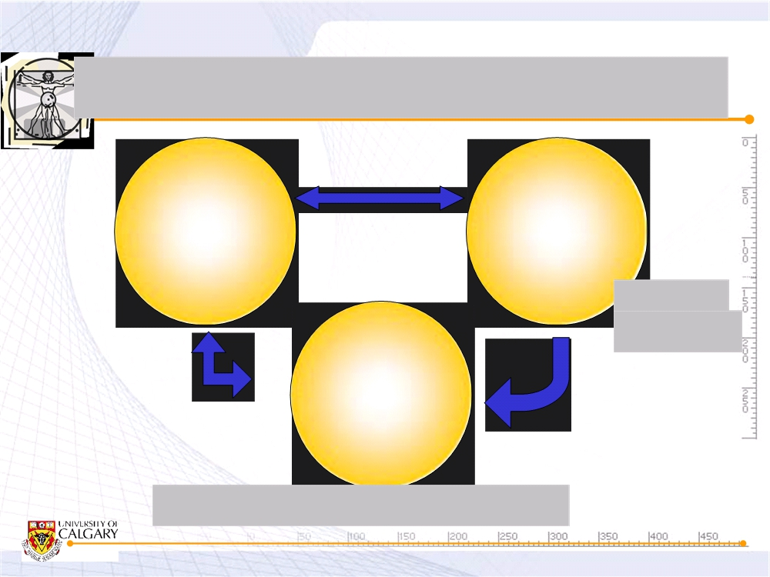
Real, Empirical & Formal Worlds
Measurement
Real
Empirical
World
World
Scales
& Units
Formal
Modeling &
World
Verification
Mapping
Mathematical
(logical) Model
far@ucalgary.ca
6

Slide 9
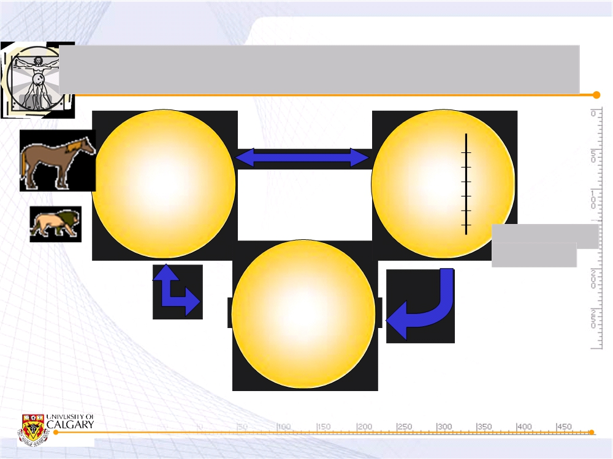
Real, Empirical & Formal Worlds
Measurement
height
Entity A
197
Entity B
124
Scale: ratio Unit: cm
M(A) > M(B)
Modeling & Verification
Mapping
far@ucalgary.ca
7

Slide 10
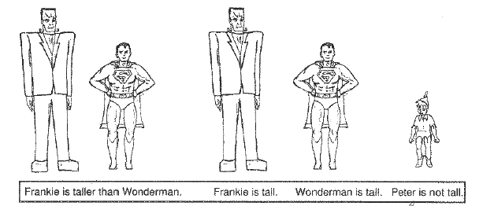
Empirical Relations of “Height”
R.Charanya,Assistant Professor,SITE, VIT University

Slide 11
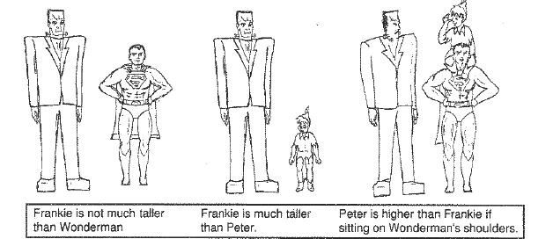
Empirical Relations for Height
R.Charanya,Assistant Professor,SITE, VIT University

Slide 12
Height is Empirical Relation
Based on consensus of opinion
Unary relation: “is tall”
Binary relation: “Arnold is taller than Danny”
Relation can map from real (or virtual) world to formal mathematical world.
R.Charanya,Assistant Professor,SITE, VIT University

Slide 13
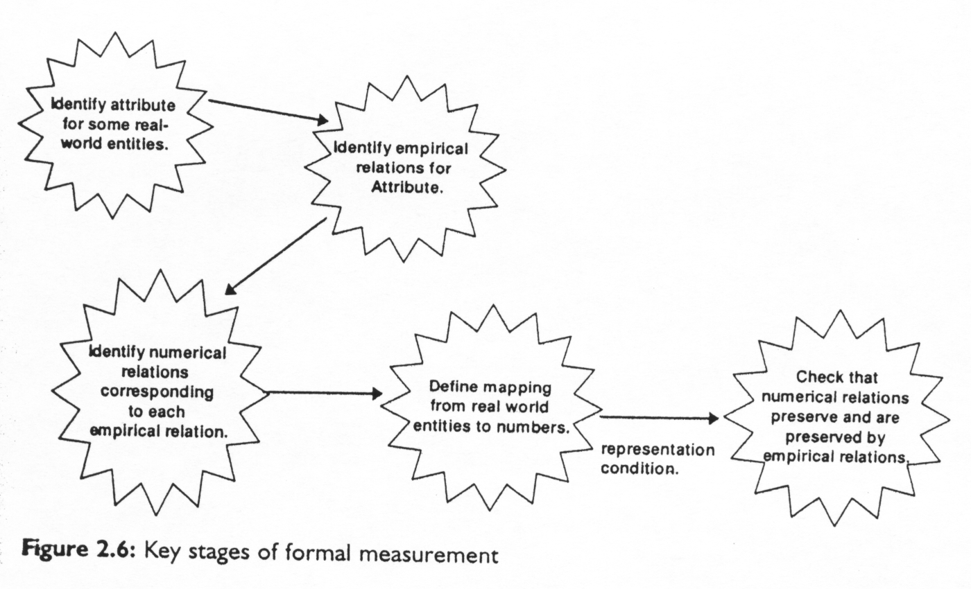
Stages of formal measurement
R.Charanya,Assistant Professor,SITE, VIT University

Slide 14
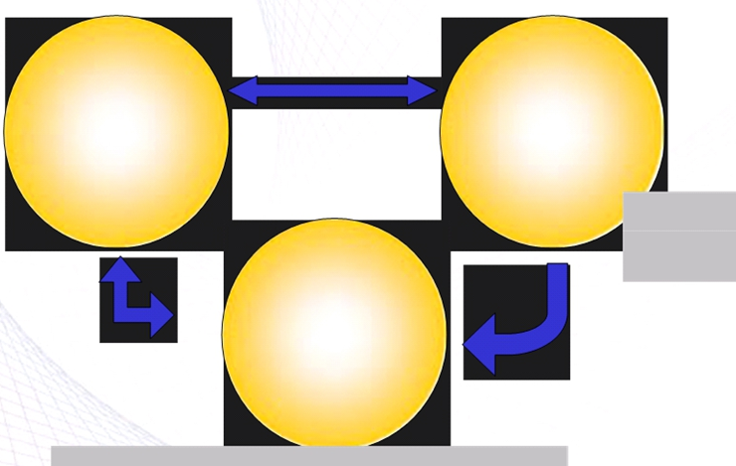
Real, Empirical & Formal Worlds
Measurement
Real World
Empirical World
Scales&Units
Modeling and
verification
Formal World
Mapping
R.Charanya,Assistant Professor,SITE, VIT University

Slide 15
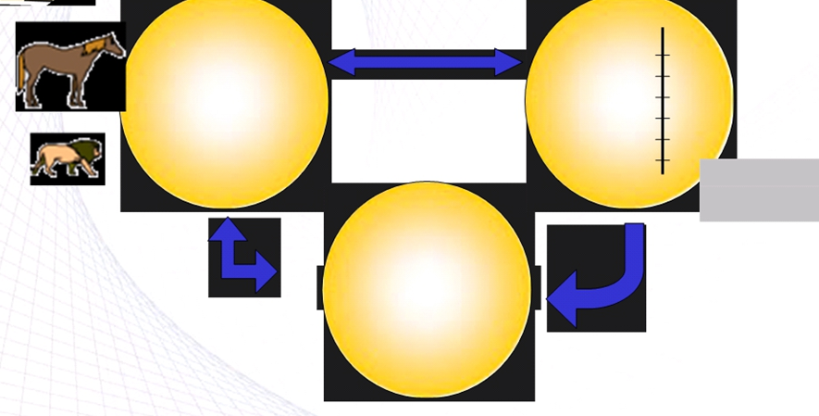
Real, Empirical & Formal Worlds
Measurement Height
Entity A
Entity B
199
108
Scale: ratio
Unit:cm
M(A)>M(B)
Modeling & Verification
Mapping
R.Charanya,Assistant Professor,SITE, VIT University

Slide 16
Mapping to the Formal World
Intuition: “Frankie is taller than Wonderman”
Measure: any height measure that give Frankie a higher number
Preservation of intuition via measurement is key to the representation condition
R.Charanya,Assistant Professor,SITE, VIT University

Slide 17
Example
4 best selling word processors
Ask 100 users to rank these according to functionality and ease of use
Each cell in table represent % of users who preferred the row’s program to the columns program (e.g. 80% rated program A as having greater functionality than program B)
Used to define “greater than” relation
R.Charanya,Assistant Professor,SITE, VIT University

Slide 18
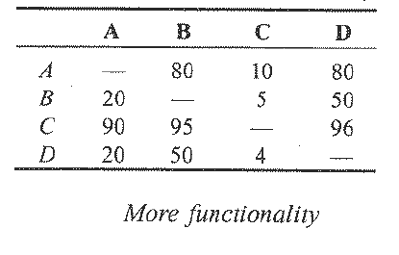
User Preferences: Functionality
Relation “greater functionality” when at least 60% agreement
Relation pairs:
{(A,B), (A,D), (C,A), (C,B), (C,D)}
-no consensus on B & D
R.Charanya,Assistant Professor,SITE, VIT University

Slide 19
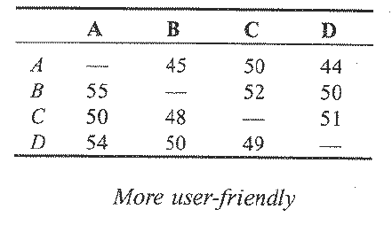
User Preferences: Ease of Use
Relation “Easier to use” when at least 60% agreement
Relation Paris: none!
There is no consensus
R.Charanya,Assistant Professor,SITE, VIT University

Slide 20
Understanding Relationships is a Prerequisite for Measurement
Need agreement on comparison before assigning numbers
Measurement improves with our understanding of attributes
History of temperature measurement
Hotter than rankings
Thermometer consistent with ranking
Fahrenheit Scale
Celsius Scale
Kelvin Scale
R.Charanya,Assistant Professor,SITE, VIT University

Slide 21
Measurement and Models
Model is an abstraction of reality , view an entity or concept from particular perspective.
Models come in different forms : as equation , mappings,or diagrams
Process measure often more difficult to define than product and resource measures, because process activities are less understood.
Eg-cost model examine only the contribute to final cost
Types of model
Cost estimation model
Quality model
CMM
R.Charanya,Assistant Professor,SITE, VIT University

Slide 22
Defining Attributes
Need to make attributes very clear
Example: program complexity
A more complex program will be more difficult to test, debug, maintain, etc.
But, do we know what complexity means?
R.Charanya,Assistant Professor,SITE, VIT University

Slide 23
A complexity measure
Cyclomatic number V(G):
Number of linearly independent paths through a program's flowgraph
V(G)=e-n+2, where e is the number of edges and n is the number of node in G
V(G)=d+1, where d is the number of decision nodes in G
Does this measure complexity?
R.Charanya,Assistant Professor,SITE, VIT University

Slide 24
Is V(g) Consistent with the notion of complexity?
Many program with los of decisions are not difficult to understand.
Ex Large case statements
V(G) does not take nested decisions into account
V(G) does not address data dependencies, or the complexity of data structures
So we need complete model of program complexity is needed
R.Charanya,Assistant Professor,SITE, VIT University

Slide 25
Conjecture
No one measure can be consisten with all notions of “complexity”
What do you think?
You may need to use extended number system, which can create only a partial ordering between entities; There many be many non-comparable entities.
R.Charanya,Assistant Professor,SITE, VIT University

Slide 26
Direct Software Measures
Software size: lines of code, number of classes, bytes of executable code, …
Time taken to repair a software defect
Number of components reused form a library.
R.Charanya,Assistant Professor,SITE, VIT University

Slide 27
Indirect Software Measures
Programmer productivity: LOC/Person-Hours
Defect density: Defects-Found/LOC
Testing branch coverage: branches Covered/Total Num Branches
R.Charanya,Assistant Professor,SITE, VIT University

Slide 28
Measurement for Prediction
Measurement is useful to understand what happen now or in the past.
Predict the reliability based on understanding of the system while still under development.
Prediction is not clear cut.
Eg-distance of future journey
Requires a prediction system: a model and methods to predict unknown parameters
R.Charanya,Assistant Professor,SITE, VIT University

Slide 29
Measurement for Prediction
Requires a mathematical model that relates attributes that can be measured to attributes that can only be predicted
Dev cost at requires time
Operational reliability when a product is released
R.Charanya,Assistant Professor,SITE, VIT University

Slide 30
Software Measurement Validation
Even when you know which entity and attribute you want to assess, there are many measures from which to choose.
• Measures or measurement systems are used to assess an existing entity by numerically characterizing one of more of its attribute.
• Prediction systems are used to predict some attribute of a future entity, involving a mathematical model with associated prediction procedures.

Slide 31
Measurement Validation
Validation question: Does the measure used to capture the information that it was intended for?
■ A measure is valid if it accurately characterizes the attribute it claims to measure.
■ A prediction system is valid if it makes accurate predictions.

Slide 32
Validating Measures
Definition: The process of ensuring that the measure is a proper numerical characterization of the claimed attribute by showing that the representation condition is satisfied.
Example: Measuring program length
Any measure of length should satisfy conditions such as:
Length of joint programs should be
m(p1 ; p2) = m(p1) + m(p2)
If length of p1 is greater than p2, any measure of length should satisfy m(p1) > m(p2).

Slide 33
Validating Prediction Systems
Definition: The process of establishing the accuracy of the prediction system by empirical means, i.e., by comparing model performance with known data in the given environment.
Example: Software Reliability
Using tools such as CASRE to fit the failure data into the reliability model.
Accuracy of estimation of the failure intensity λ depends on the number of failures experienced (i.e., the sample size).
Good results in estimating failure intensity are generally experienced for programs with 5,000 or more developed source lines.

Slide 34
Classes of Prediction Systems
Class 1: Measures of internal attributes of early life-cycle products predict measures of internal attributes of later life-cycle products.
Example: Reuse of specification are used to predict size and final code.

Slide 35
(cont’d)
Class 2: Measures of early life-cycle process attributes predict measures of later life-cycle processes and resources.
Example:
-- Number of faults found during design review predict cost of implementation.
– Number of faults(old shirt damage)-predict cost of implementation(predict the cost)

Slide 36
Class 3: Measures of internal product attributes predict process attributes.
Example:
– Measures of design structure to predict maintenance effort, or the number of faults found during testing.
–

Slide 37
Class 4: Measures of process attributes predict later product attributes.
Example:
Measure of failure during one operational period are used to predict likely failure occurrence in the subsequent operational period.
2. Failures during testing predict reliability in the field.

